Slide 1
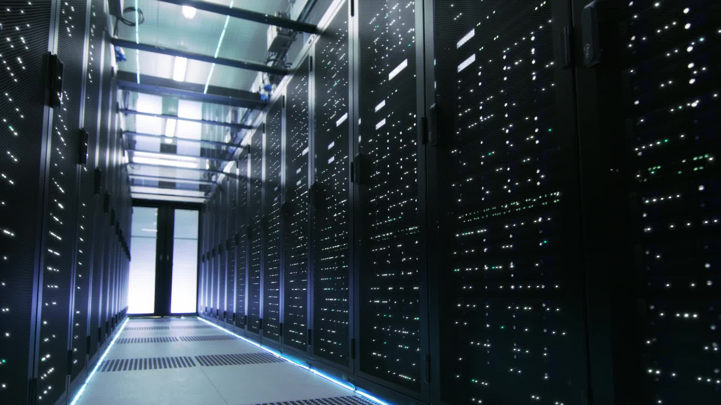
GPU power variability in ML Systems

Slide 2
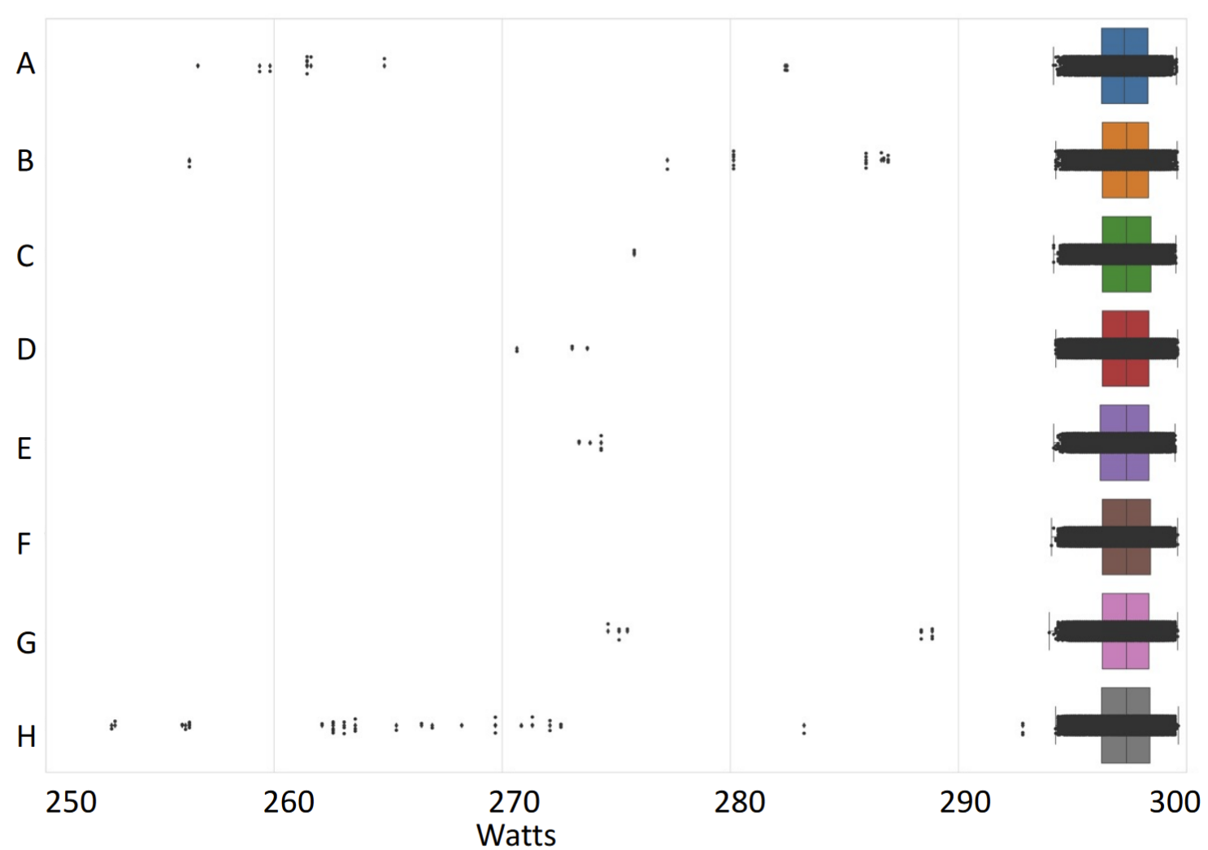

Slide 3
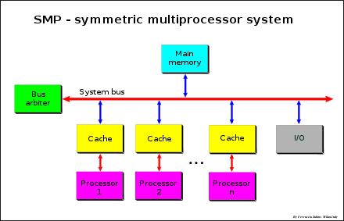
Prior Work
Focus mainly on CPUs
Studies often at device level rather than system level
Proposed solutions assume symmetry in operation of all participating nodes
unlike real world systems
Notes:
[a] R. Nath, D. Tullsen, Chapter 18 - Accurately modeling GPGPU frequency scaling with the CRISP performance model, In Emerging Trends in Computer Science and Applied Computing, Advances in GPU Research and Practice
Image credits - https://upload.wikimedia.org/wikipedia/commons/thumb/1/1c/SMP_-_Symmetric_Multiprocessor_System.svg/880px-SMP_-_Symmetric_Multiprocessor_System.svg.png

Slide 4
Plan
Profiling: Factors that affect variability
Characterization: ML [Systems + Workloads]
Mitigation
Notes:
Identify parameters to quantify power variability via profiling + those that can be treated as constants during analysis
Identify data parallel workloads and patterns in ML workloads that tend to exhibit such variations
Power-aware scheduling to navigate the power-performance tradeoff problem in GPUs:
Higher power draw than CPU, susceptible to intra/inter-device variations
Use of multi-GPU clusters with high BW interconnects ↑, susceptibility to inter-device variations ↑, due to spatial locality

Slide 5
Expected output
Profiling
Analysis model for variability
Characterization
Data collection and analysis of stressmark for ML workloads
Mitigation
Techniques to

